Slide 1

LAW OF RETURNS TO SCALE

Slide 2
DEFINATION
It is defined as the changes in output that occur when all input factors such as labor, capital, and land are increased proportionately and concurrently.
It focuses on the long-term production process, where all inputs are changeable, as opposed to the short-term production process, which has certain constant inputs.
It determines whether output increases more quickly, equally, or more slowly than inputs by analyzing production efficiency as a company or organization expands operations.

Slide 3
RELEVANCE AND PURPOSE
For companies wishing to grow or shrink, this law is essential.
Businesses can make well-informed judgments on cost effectiveness, production capacity, and resource allocation by comprehending returns to scale.

Slide 4
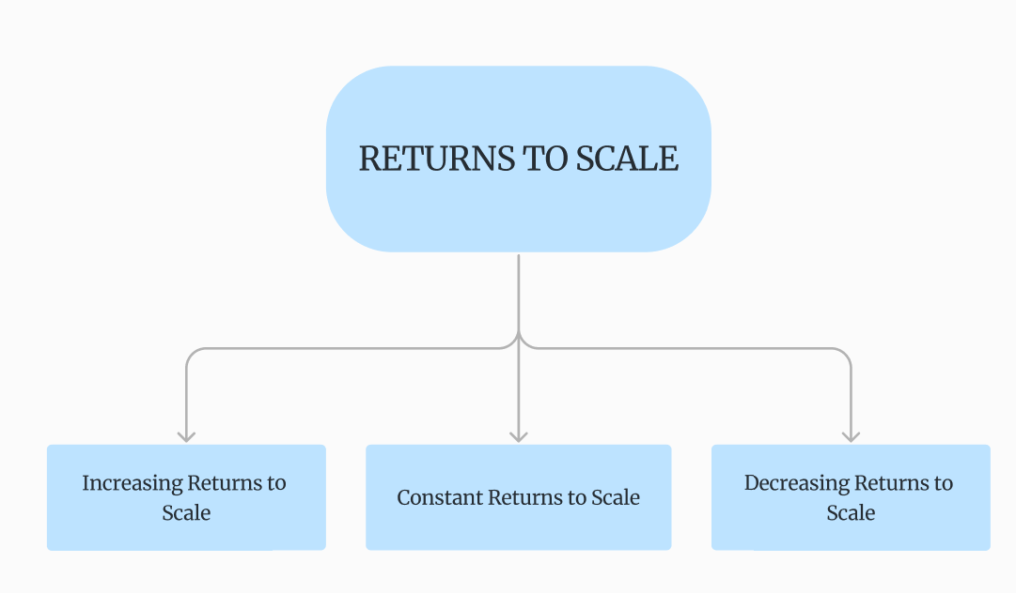
TYPES OF RETURNS TO SCALE

Slide 5
There is three types of Law of returns to scale :
Increasing Returns to Scale (IRS)
Constant Returns to Scale (CRS)
Decreasing Returns to Scale (DRS)

Slide 6
Increasing Returns to Scale (IRS)
When the output grows by a larger percentage than the rise in all inputs, this is referred to as increasing returns to scale (IRS).
For instance, the production process is experiencing growing returns to scale if all inputs are doubled and output more than doubles.
Better resource management, increased specialization, and economies of scale where higher output levels result in lower average costs are some of the factors driving IRS.

Slide 7
TABULATION
Input Level | Capital (K) | Labour (L) | Total Input (K+L) | Output (Q)
1 | 10 | 10 | 20 | 30
2 | 20 | 20 | 40 | 70
3 | 30 | 30 | 60 | 120
4 | 40 | 40 | 80 | 180
5 | 50 | 50 | 100 | 250

Slide 8
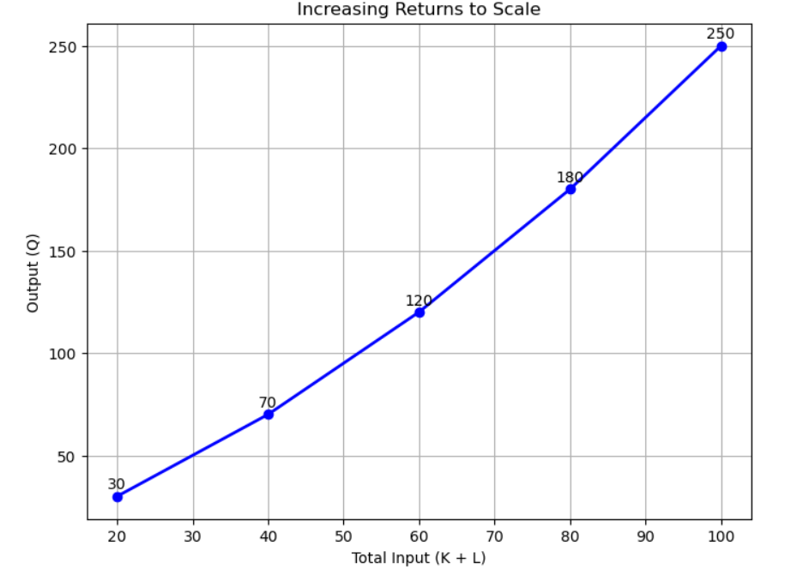
GRAPHICAL REPRESENTATION

Slide 9
Constant Returns to Scale
When the output rises in direct proportion to the growth in all inputs, this is known as constant returns to scale, or CRS.
To put it another way, the output doubles if all the inputs double.
represents an ideal scale at which resources are used at their full potential without experiencing a rise in inefficiencies or new efficiencies.
It shows that the manufacturing environment is balanced.

Slide 10
TABULATION
Input Level | Capital (K) | Labour (L) | Total Input (K+L) | Output (Q)
1 | 10 | 10 | 20 | 40
2 | 20 | 20 | 40 | 80
3 | 30 | 30 | 60 | 120
4 | 40 | 40 | 80 | 160
5 | 50 | 50 | 100 | 200

Slide 11
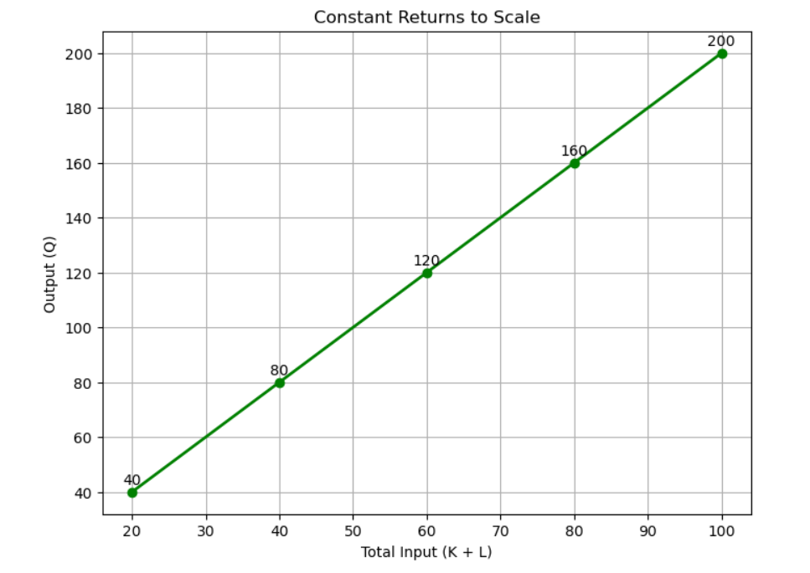
GRAPHICAL REPRESENTATION

Slide 12
Decreasing Returns to Scale (DRS)
When all inputs are scaled up proportionately, the output increases, but at a decreasing pace relative to the input increase, according to the concept of Decreasing Returns to Scale (DRS).
The output rises more slowly than the inputs in this returns to scale scenario.
Usually, this occurs when an industrial process loses efficiency.

Slide 13
TABULATION
Input Level | Capital (K) | Labour (L) | Total Input (K+L) | Output (Q)
1 | 10 | 10 | 20 | 30
2 | 20 | 20 | 40 | 55
3 | 30 | 30 | 60 | 75
4 | 40 | 40 | 80 | 90
5 | 50 | 50 | 100 | 100

Slide 14
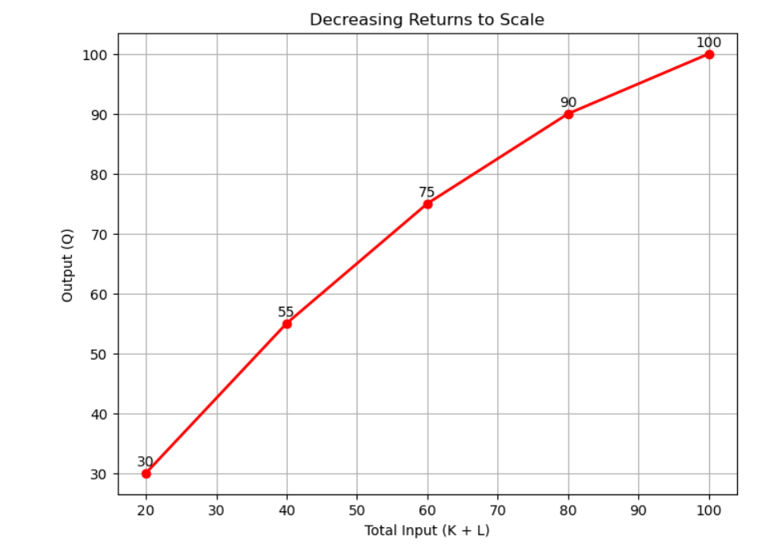
GRAPHICAL REPRESENTATION

Slide 15
CONCLUSION
It assists companies in figuring out the most productive level.
It impacts choices about introducing new technology, combining resources, and growing or shrinking businesses.
It evaluates the effect of increasing resources on industrial output to inform long-term planning.

